Slide 1
INTEGRATED PATIENT CARE SYSTEM
Submitted in the partial fulfillment for the award of the degree of
BACHELOR OF ENGINEERING
IN
Computer Science and Engineering with Specialization in AIML
Submitted by:
Anirudh Sharma : 22BAI70109
Siddhant Gupta : 22BAI70088
Vedansh Maheshwari : 22BAI70056
Under the Supervision of:
Prof. Jaswinder Singh
Department of AIT-CSE
DISCOVER . LEARN . EMPOWER

Slide 2
Outline
Introduction to Project
Problem Formulation
Objectives of the work
Methodology used
Results and Outputs
Conclusion
Future Scope
References

Slide 3
INTRODUCTION
Today, we're diving into a critical aspect of modern healthcare: the Integrated Patient Care System. In an era marked by rapid advancements and increasing complexities in healthcare delivery, the need for seamless coordination and collaboration among healthcare providers has never been more pressing. The Integrated Patient Care System offers a comprehensive solution—a paradigm shift towards a patient-centric approach that prioritizes collaboration, communication, and continuity of care. Let's explore how this innovative model is transforming the healthcare landscape, enhancing patient outcomes, and revolutionizing the way we deliver care.
As we delve into this transformative model, we recognize the pressing need for healthcare systems to adapt and evolve. Traditional approaches, while effective in their own right, often fall short in providing the seamless, patient-centered care that is increasingly demanded by both patients and providers alike.

Slide 4
INTRODUCTION(Contd.)
Throughout this presentation, we will explore the fundamental principles, key components, and tangible benefits of the Integrated Patient Care System. From enhanced patient outcomes to improved efficiency and personalized care, we will uncover the myriad ways in which this innovative approach is reshaping the future of healthcare delivery.
Join us as we embark on a journey to explore the transformative power of the Integrated Patient Care System—a journey that promises to redefine the way we perceive, deliver, and experience healthcare in the 21st century.

Slide 5
PROBLEM FORMULATION
In traditional healthcare systems, the delivery of care often suffers from fragmentation, inefficiencies, and a lack of coordination among healthcare providers. This fragmented approach leads to several critical issues:
Silos in Care Delivery: Healthcare services are typically delivered in silos, with limited communication and collaboration among various healthcare professionals. This disjointed approach can result in gaps in care, duplicated efforts, and inconsistent treatment plans, ultimately impacting patient outcomes.
Poor Continuity of Care: Transitions between different levels of care, from primary care to specialty services and beyond, are often disjointed and poorly managed. Patients may experience disruptions in their care journey, leading to potential medical errors, unnecessary hospital readmissions, and increased healthcare costs.

Slide 6
PROBLEM FORMULATION(Contd.)
In light of these challenges, there is a pressing need for a transformative solution that promotes collaboration, communication, and continuity of care across all stages of the patient journey. The Integrated Patient Care System aims to address these shortcomings by fostering interdisciplinary collaboration, streamlining care coordination, empowering patients, and optimizing resource utilization. By addressing these fundamental issues, the Integrated Patient Care System seeks to enhance patient outcomes, improve efficiency, and ultimately, transform the healthcare experience for all stakeholders involved.

Slide 7
OBJECTIVES OF WORK
The objective of exploring the Integrated Patient Care System is to understand its fundamental principles, key components, and potential impact on healthcare delivery. Through this exploration, we aim to:
Gain Insight: Develop a comprehensive understanding of the concept of integrated patient care, including its definition, core principles, and underlying philosophy.
Identify Components: Identify the key components and elements that comprise an Integrated Patient Care System, such as interdisciplinary collaboration, care coordination, patient engagement, and technology integration.
Explore Benefits: Explore the potential benefits of implementing an Integrated Patient Care System, including improved patient outcomes, enhanced efficiency, personalized care delivery, and better population health management.

Slide 8
METHODOLOGY USED
Literature Review: Comprehensive review of existing literature, research studies, and industry reports to understand integrated patient care's conceptual framework, components, benefits, and challenges.
Case Studies: Analysis of real-world examples of successful integrated patient care initiatives to extract insights, strategies, and lessons learned.
Surveys and Interviews: Gathering qualitative and quantitative data from healthcare professionals, patients, and stakeholders to understand their perspectives and experiences with integrated care.
Data Analysis: Utilization of healthcare data, including electronic health records, patient outcomes, and utilization data, to assess the impact of integrated patient care on various metrics such as clinical outcomes and cost-effectiveness.

Slide 9
RESULTS AND OUTPUT
Increased Understanding: Audience members will gain a deeper understanding of the Integrated Patient Care System, including its principles, components, and benefits.
Awareness of Challenges: Attendees will become aware of the challenges and barriers associated with implementing integrated patient care, such as interoperability issues and resistance to change.
Identification of Opportunities: Participants will identify opportunities for improving patient outcomes, enhancing efficiency, and fostering collaboration within their healthcare organizations through the adoption of integrated care models.
Inspiration for Action: The presentation will inspire healthcare professionals, policymakers, and stakeholders to take action towards implementing or advocating for integrated patient care initiatives within their respective organizations or communities.

Slide 10
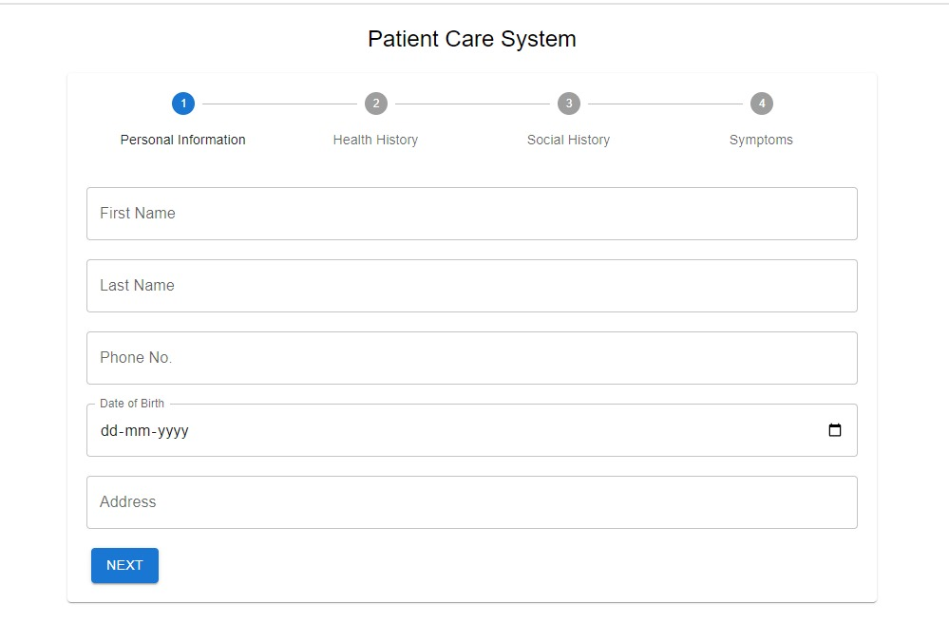
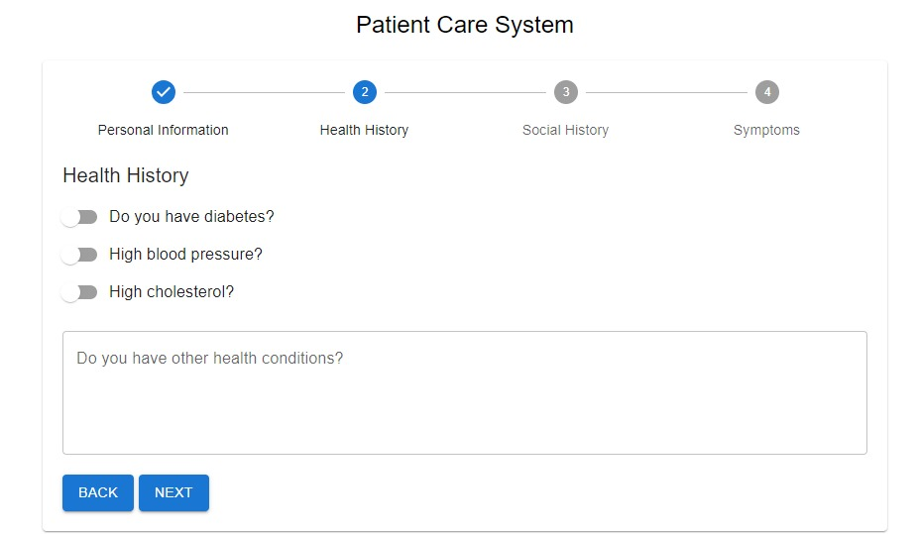
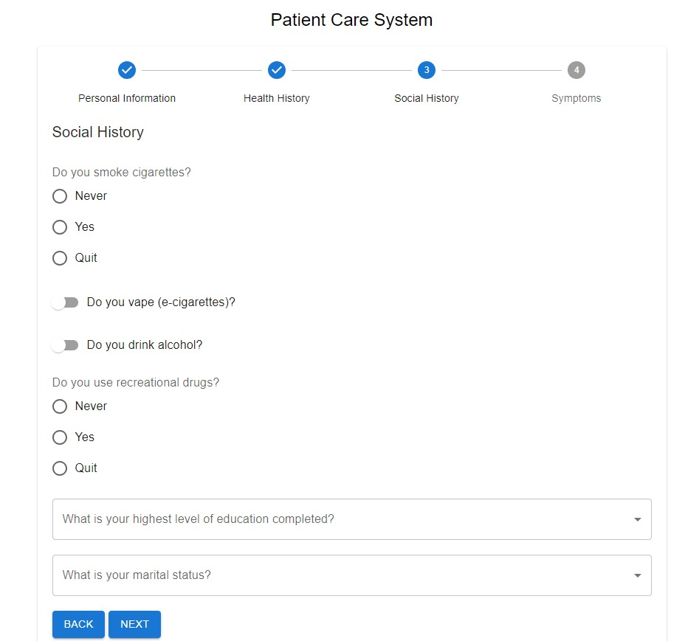
Step I
Step II
Step III

Slide 11
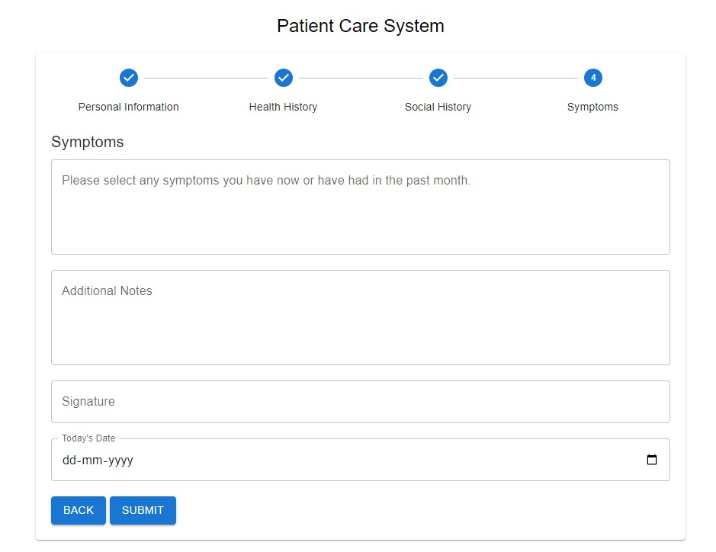

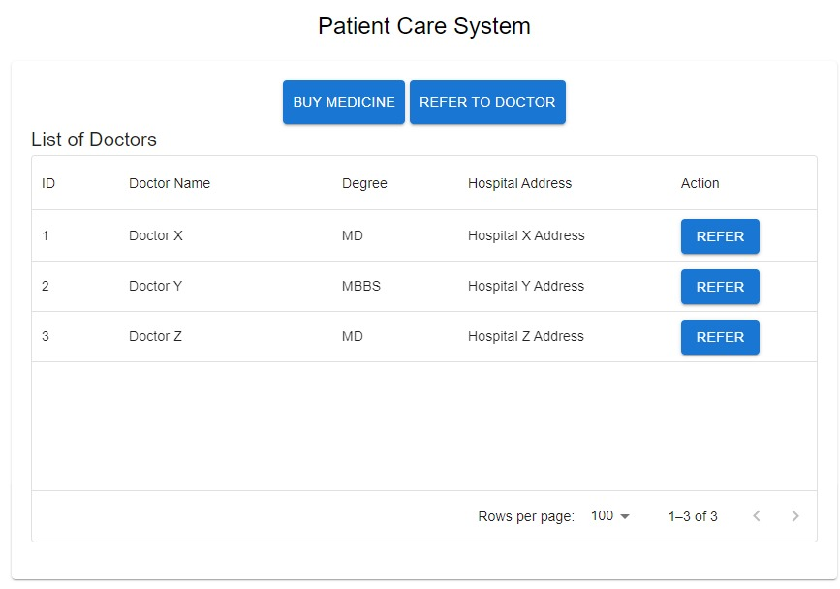
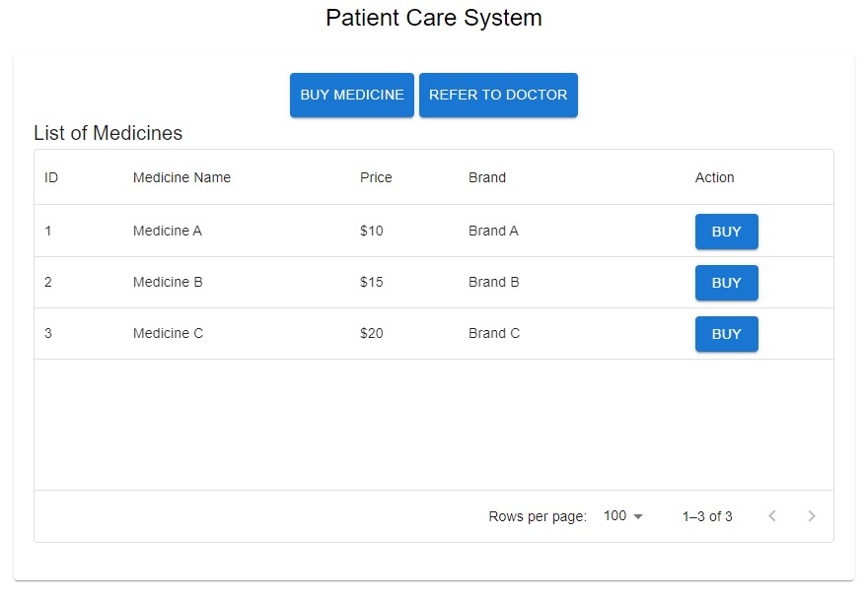
Step V
Step IV
Step V(a)
Step V(b)

Slide 12
CONCLUSION
In conclusion, our exploration of the Integrated Patient Care System has shed light on a transformative approach to healthcare delivery—one that places patients at the center and emphasizes collaboration, coordination, and continuity of care. Through this journey, we've uncovered the fundamental principles, key components, challenges, and opportunities associated with integrated care models.
However, implementing integrated care is not without its challenges. It requires overcoming barriers, fostering cultural change, and leveraging technology effectively. Yet, as evidenced by the success stories and best practices shared today, the rewards of embracing integrated care are profound.
Therefore, let us leave this presentation with a renewed sense of purpose and commitment—to champion integrated patient care within our organizations, communities, and healthcare systems. Let us collaborate, innovate, and advocate for change, knowing that together, we can create a future where every patient receives the seamless, coordinated, and compassionate care they deserve.

Slide 13
FUTURE SCOPE
Technological Advancements: Continued advancements in technology, such as artificial intelligence, predictive analytics, and remote monitoring devices, will further enhance the capabilities of integrated patient care systems. These technologies will enable more personalized, precise, and proactive approaches to healthcare delivery, leading to improved patient outcomes and population health management.
Interoperability and Data Exchange: Efforts to improve interoperability and data exchange among healthcare systems and stakeholders will play a crucial role in advancing integrated patient care. Seamless exchange of health information will facilitate better coordination, communication, and continuity of care across different settings and providers.
Patient-Centered Innovations: The future of integrated patient care will prioritize patient-centered innovations, empowering individuals to take an active role in their healthcare journey. From personalized treatment plans to self-management tools and virtual care options, these innovations will promote patient engagement, autonomy, and empowerment.

Slide 14
REFERENCES
What Is Integrated Health Care and How Will It Affect Me? (n.d.) retrieved March 29, 2024, from online.queens.edu
2. Bookshelf. (n.d.) retrieved March 29, 2024, from www.ncbi.nlm.nih.gov/books/NBK564902/
3. Understanding Integrated Care. (n.d.) retrieved March 29, 2024, from www.ncbi.nlm.nih.gov/pmc/articles/PMC5354214/
4. Ten Key Principles for Successful Health Systems Integration. (n.d.) retrieved April 12, 2024, from www.ncbi.nlm.nih.gov/pmc/articles/PMC3004930/
5.Integrated Health Care System. (n.d.) retrieved April 12, 2024, from www.sciencedirect.com
6. What Is Integrated Health Care and What Does It Mean for You? | St. Luke's Health. (n.d.) retrieved April 12, 2024, from www.stlukeshealth.org
7. Perspective: Integrated Health Systems Help Enhance Value, Access for Patients and Communities | AHA News. (n.d.) retrieved April 12, 2024, from www.aha.org
8. Bookshelf. (n.d.) retrieved April 12, 2024, from www.ncbi.nlm.nih.gov/books/NBK564902/
References:

Slide 15
REFERENCES
9. Valentijn, P. P., Schepman, S. M., Opheij, W., & Bruijnzeels, M. A. (2013). Understanding integrated care: a comprehensive conceptual framework based on the integrative functions of primary care. International Journal of Integrated Care, 13, e010.
10. Kodner, D. L., & Spreeuwenberg, C. (2002). Integrated care: meaning, logic, applications, and implications – a discussion paper. International Journal of Integrated Care, 2, e12.
11. Haggerty, J. L., Reid, R. J., Freeman, G. K., Starfield, B. H., Adair, C. E., & McKendry, R. (2003). Continuity of care: a multidisciplinary review. BMJ, 327(7425), 1219-1221.
12. Greenhalgh, T., Wherton, J., Papoutsi, C., Lynch, J., Hughes, G., A'Court, C., ... & Shaw, S. (2018). Beyond adoption: a new framework for theorizing and evaluating nonadoption, abandonment, and challenges to the scale-up, spread, and sustainability of health and care technologies. Journal of Medical Internet Research, 20(5), e10073.
13. Ham, C., Imison, C., & Goodwin, N. (2011). What is the evidence on interventions to manage referral from primary to specialist non-emergency care? London: The King's Fund.
14. Struijs, J. N., Baan, C. A., Schellevis, F. G., Westert, G. P., & van den Bos, G. A. (2012). Comorbidity in patients with diabetes mellitus: impact on medical health care utilization. BMC Health Services Research, 12(1), 1-7.
15. Goodwin, N., Dixon, A., Anderson, G., & Wodchis, W. (2014). Providing integrated care for older people with complex needs: lessons from seven international case studies. The King's Fund.

